Slide 1

Trading robot
Developed by: Moldovan Andrei, Moldovan Ioana Ilinca
Supervised by: Pop Daniel

Slide 2
Problem
More and more individuals and companies realize the importance of investing
Also the importance of passive income streams
Cryptocurrency offers a lot of potential for growth
This requires constant research to be able to buy/sell at the proper time

Slide 3


Slide 4


Slide 5


Slide 6
Solution
Automatisation
Have a robot do the job for you

Slide 7


Slide 8
Approach - briefly
Robot starts
Reads website url format from input excel sheet
Reads stocks and crypto symbols form input excel sheet
Generates formatted URLs for each symbol
Navigates to each of those URLs, scrapes data from screen and formats it
Saves data to data table
Writes data table to excel history sheet and to new excel file for email sending
Reads email addresses of users from input excel sheet
Sends the file for that given day to each of those addresses

Slide 9
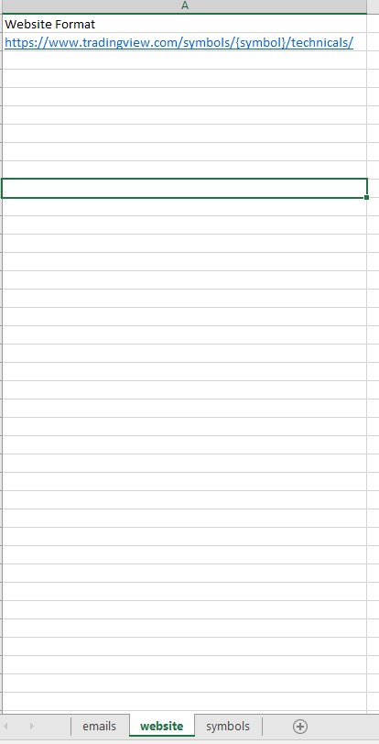
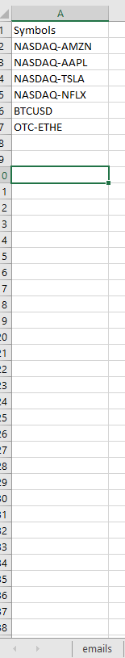
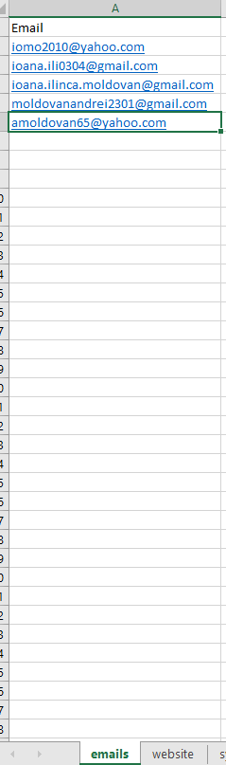

Slide 10
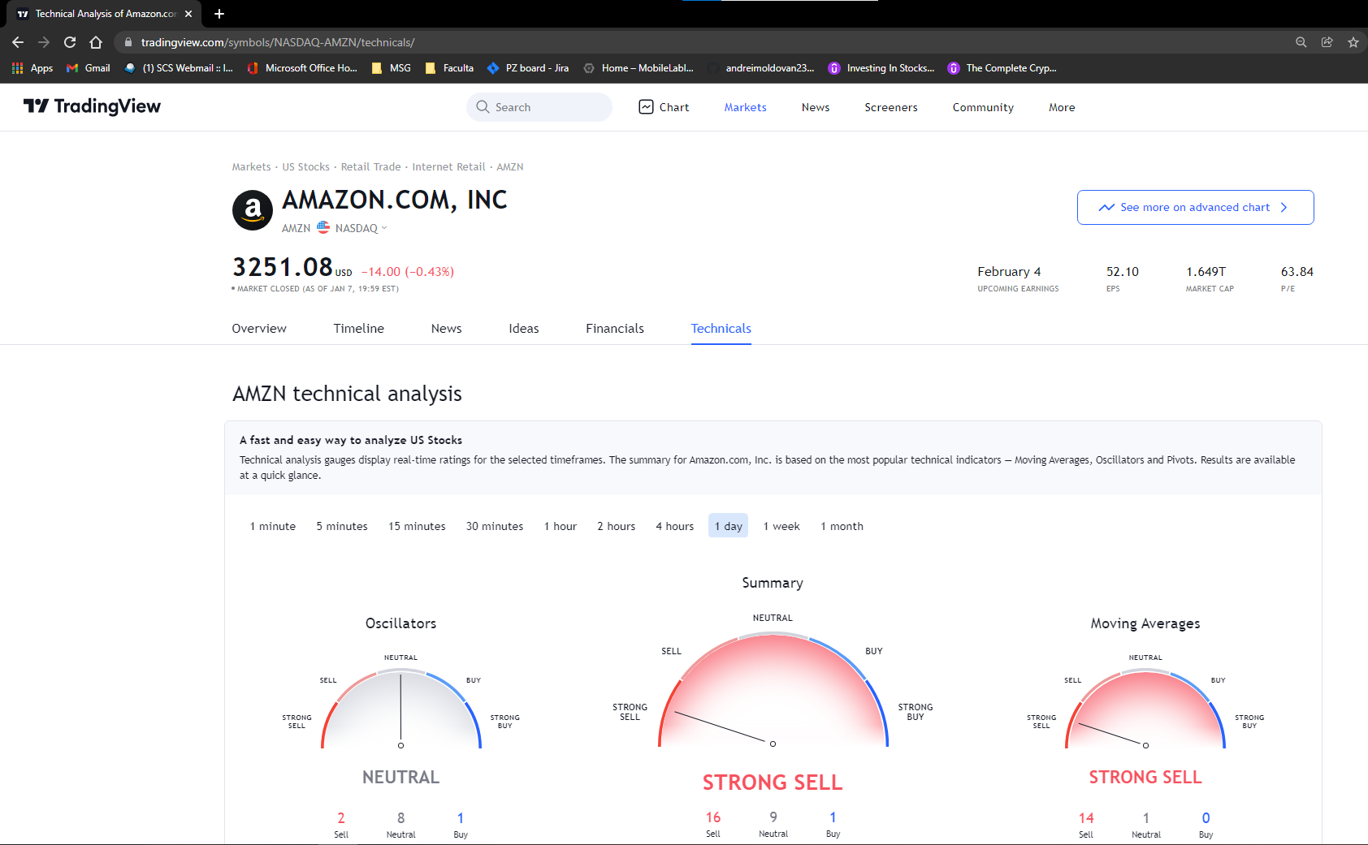

Slide 11
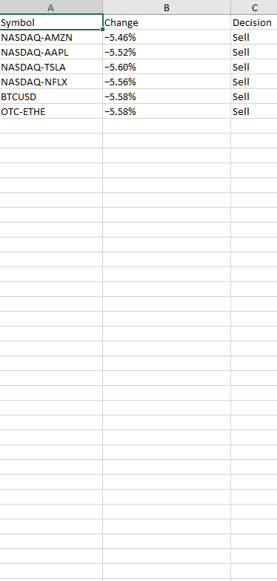

Slide 12
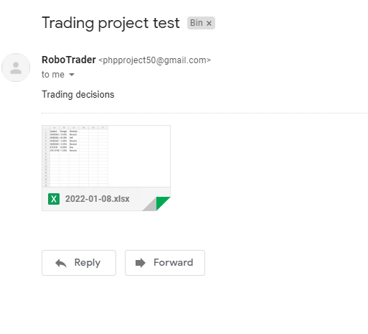

Slide 13


